Slide 1
TAMIL SIGN LANGUAGE RECOGNITION USING MACHINE LEARNING
Submitted By:
Name | Roll Number
Abirami Ramanathan | 2023103020
Hashim M | 2023103017
Hariharan B | 2023103704

Slide 2
Background
Tamil is an ancient language with 247 characters used by millions worldwide.
Deaf and mute communities face communication barriers due to sign language understanding.
Existing sign recognition research mainly targets ASL and BSL languages globally widely.
Tamil Sign Language research remains limited with character coverage and real-time performance.
Advances in computer vision and machine learning enable improved hand gesture analysis.

Slide 3
Motivation
Bridge the communication between deaf users and general public through real-time translation systems.
Develop accurate, scalable Tamil sign language recognition using modern machine learning techniques.
Address limitations of controlled environments by enabling robust real-world gesture recognition systems.
Leverage MediaPipe hand landmarks to improve accuracy and real-time performance sign recognition.
Promote inclusivity and social participation within Tamil-speaking deaf and mute communities globally.

Slide 4
Problem Statement
Tamil sign communication is hindered by complex alphabets and lack of accurate real-time systems.
There is a need for an efficient real-time ML system to enable communication between deaf users and the general public.
Key Problems
  Limited real-time Tamil sign language recognition systems
  High complexity due to 247 Tamil characters
  Low public familiarity with Tamil sign language
  Inadequate accuracy and scalability in existing solutions
  Communication barriers leading to social exclusion for the deaf and mute

Slide 5
General Objectives
Bridge Communication Gaps for Tamil-speaking deaf/mute community
Develop Lightweight Recognition System (without GPU usage)
Enable Real-time Recognition via webcam
Ensure Device Accessibility for resource-constrained devices
Promote Inclusivity for hearing/speech impaired individuals
Advance Regional Sign Language Research for Tamil

Slide 6
Specific Objectives
To Design a real-time Tamil Sign Language recognition system
To construct and scale a structured feature dataset from TLFS23 landmark representations.
To apply machine learning techniques, specifically Random Forest, for classification of the 247 Tamil alphabet classes
To extract robust hand landmark features using MediaPipe for Tamil sign gestures.
To extend the system from isolated alphabet recognition to word-level generation using temporal aggregation
To provide a user-friendly real-time interface for live sign prediction

Slide 7
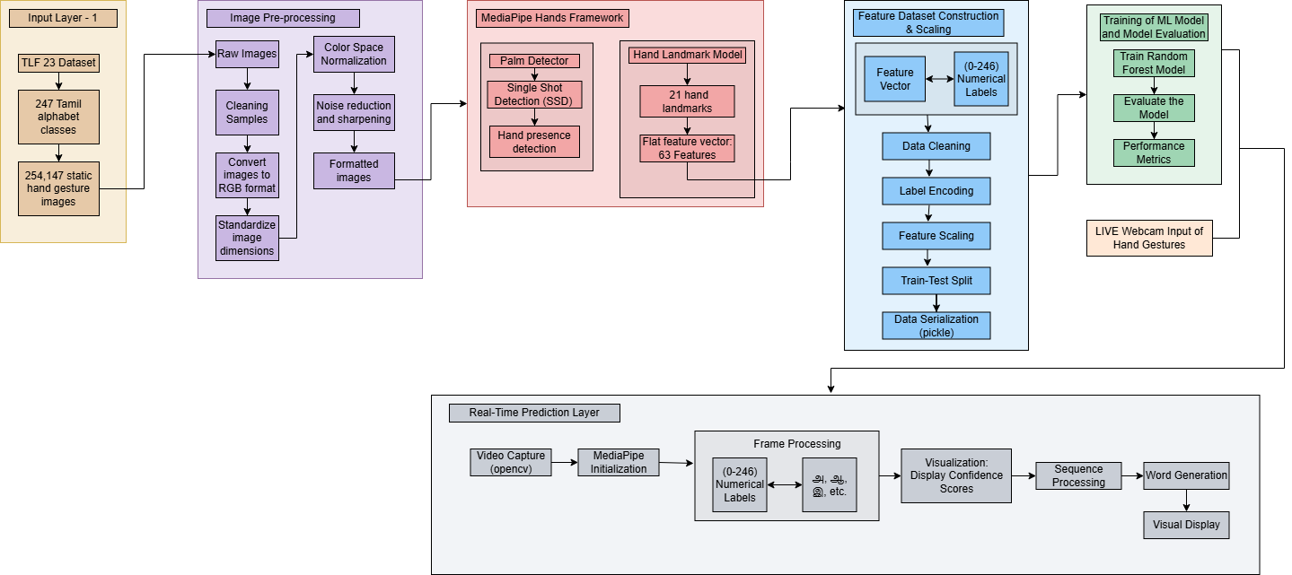
Tamil Sign Language Recognition Framework

Slide 8
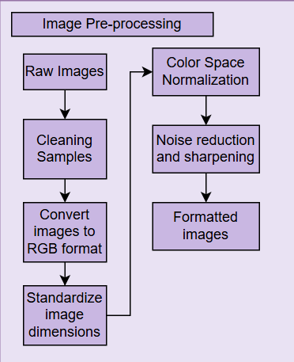
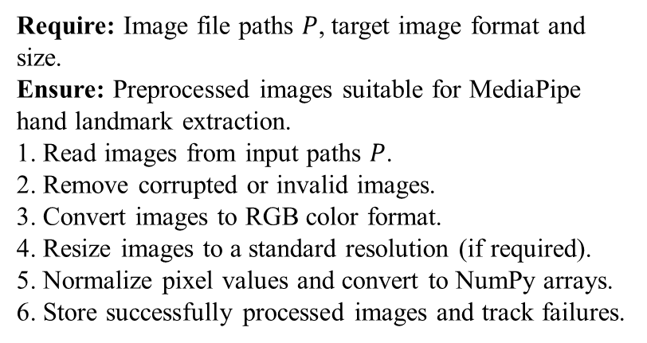
Module 1: Image Pre-processing
Algorithm:
Require: Image file paths $P$, target image format and size.
Ensure: Preprocessed images suitable for MediaPipe hand landmark extraction.
1. Read images from input paths $P$.
2. Remove corrupted or invalid images.
3. Convert images to RGB color format.
4. Resize images to a standard resolution (if required).
5. Normalize pixel values and convert to NumPy arrays.
6. Store successfully processed images and track failures.
Description:
Performs normalization, resizing, and format conversion on raw TLFS23 dataset images.
Ensures images meet MediaPipe input requirements for accurate hand landmark extraction.
Enhances image quality and standardizes dimensions to improve hand detection reliability.

Slide 9
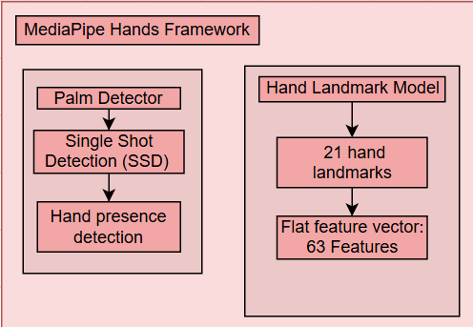
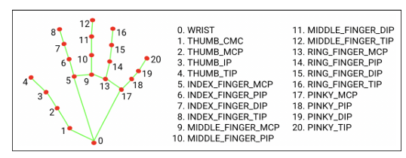
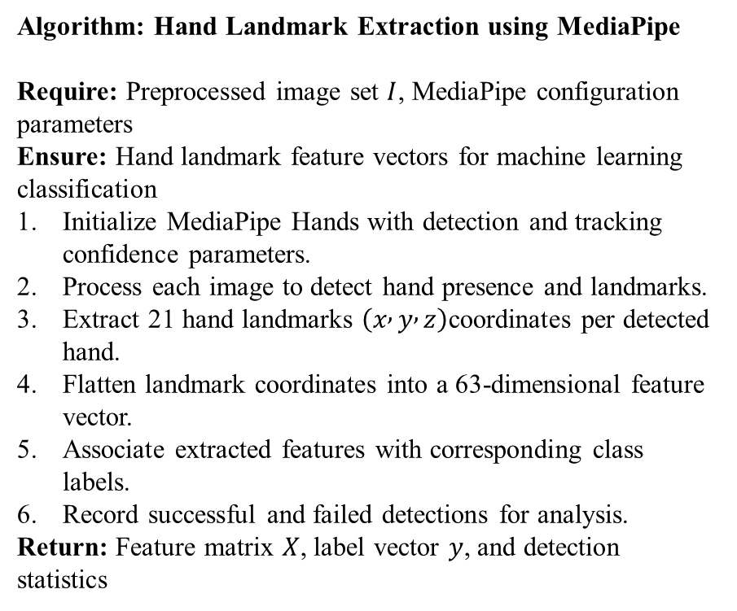
Module 2: MediaPipe Hands Framework
Algorithm: Hand Landmark Extraction using MediaPipe
Require: Preprocessed image set $I$, MediaPipe configuration parameters
Ensure: Hand landmark feature vectors for machine learning classification
Initialize MediaPipe Hands with detection and tracking confidence parameters.
Process each image to detect hand presence and landmarks.
Extract 21 hand landmarks $\left(x , y , z\right)$coordinates per detected hand.
Flatten landmark coordinates into a 63-dimensional feature vector.
Associate extracted features with corresponding class labels.
Record successful and failed detections for analysis.
Return: Feature matrix $X$, label vector $y$, and detection statistics
Key points marked by Mediapipe Hand Landmarks

Slide 10
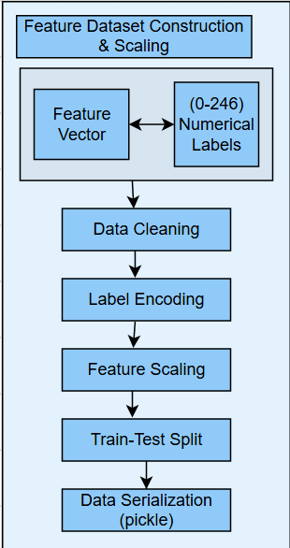
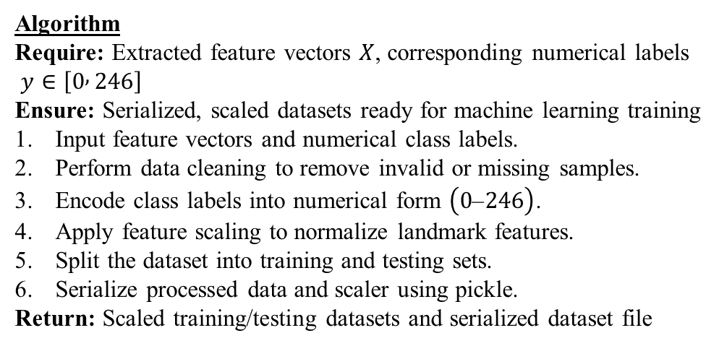
Module 3: Dataset Construction & Scaling
Algorithm
Require: Extracted feature vectors $X$, corresponding numerical labels
$y∈\left[0 , 246\right]$
Ensure: Serialized, scaled datasets ready for machine learning training
Input feature vectors and numerical class labels.
Perform data cleaning to remove invalid or missing samples.
Encode class labels into numerical form $\left(0\text{–}246\right)$.
Apply feature scaling to normalize landmark features.
Split the dataset into training and testing sets.
Serialize processed data and scaler using pickle.
Return: Scaled training/testing datasets and serialized dataset file
Description
Aggregates hand landmark features, organizes datasets, and serializes data using pickle format.
Applies feature scaling and train-test splitting to improve classifier performance.

Slide 11
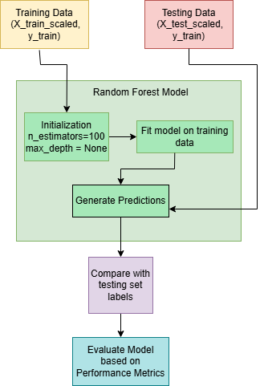
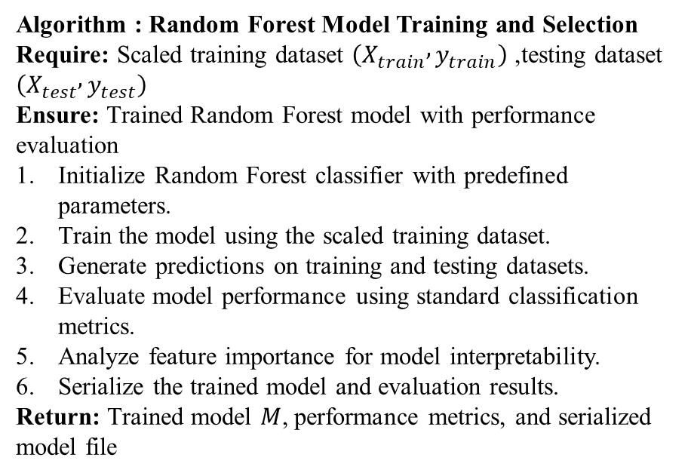
Module 4: Random Forest Model Training
Algorithm : Random Forest Model Training and Selection
Require: Scaled training dataset $\left(X_{train} , y_{train}\right)$, testing dataset $\left(X_{test} , y_{test}\right)$
Ensure: Trained Random Forest model with performance evaluation
Initialize Random Forest classifier with predefined parameters.
Train the model using the scaled training dataset.
Generate predictions on training and testing datasets.
Evaluate model performance using standard classification metrics.
Analyze feature importance for model interpretability.
Serialize the trained model and evaluation results.
Return: Trained model $M$, performance metrics, and serialized model file

Slide 12
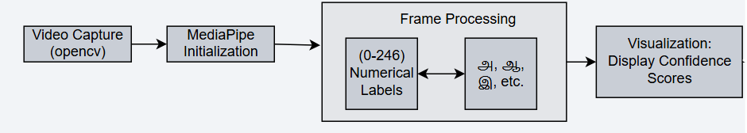
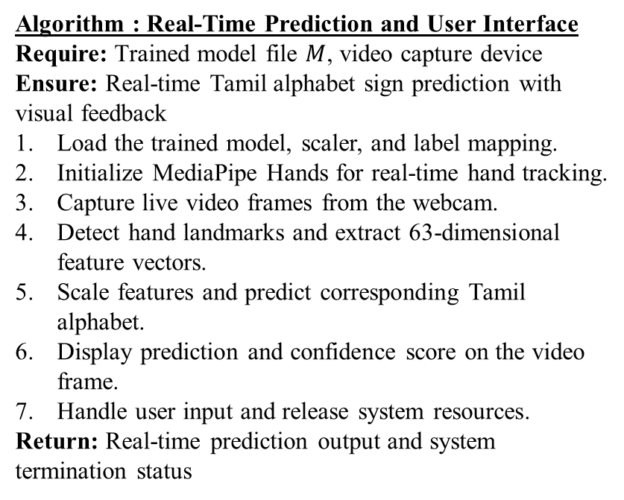
Module 5: Real-Time Alphabet Prediction
Trained RF Model
LIVE Webcam Input of Hand Gestures
Algorithm : Real-Time Prediction and User Interface
Require: Trained model file $M$, video capture device
Ensure: Real-time Tamil alphabet sign prediction with visual feedback
Load the trained model, scaler, and label mapping.
Initialize MediaPipe Hands for real-time hand tracking.
Capture live video frames from the webcam.
Detect hand landmarks and extract 63-dimensional feature vectors.
Scale features and predict corresponding Tamil alphabet.
Display prediction and confidence score on the video frame.
Handle user input and release system resources.
Return: Real-time prediction output and system termination status
Description
Captures live video, extracts hand landmarks, and predicts Tamil alphabet signs.
Displays real-time predictions, landmarks, and visual feedback through user interface.

Slide 13
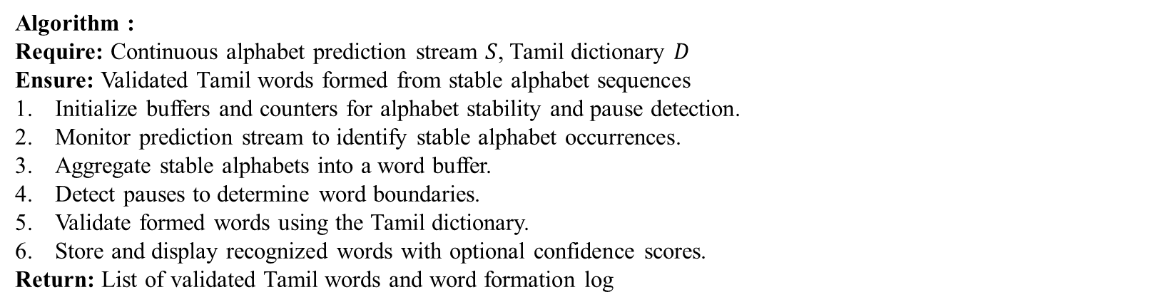
Module 6: Alphabet Sequence Aggregation & Word Generation
Algorithm :
Require: Continuous alphabet prediction stream $S$, Tamil dictionary $D$
Ensure: Validated Tamil words formed from stable alphabet sequences
Initialize buffers and counters for alphabet stability and pause detection.
Monitor prediction stream to identify stable alphabet occurrences.
Aggregate stable alphabets into a word buffer.
Detect pauses to determine word boundaries.
Validate formed words using the Tamil dictionary.
Store and display recognized words with optional confidence scores.
Return: List of validated Tamil words and word formation log

Slide 14
Dataset Interpretation
Attribute | Details
Dataset Name | TLFS23 (Tamil Language Finger Spelling 2023)
Total Images | 254,147 static RGB hand gesture images
Total Classes | 247 Tamil characters + 1 background class
Images per Class | ~1,000 images per class
Participants | 120 individuals aged 15–80 years
Character Types | Vowels, consonants, compound characters
Data Source | Publicly available on Mendeley Data

Slide 15
Performance Evaluation Metrics
Metric | Significance
Confusion Matrix | Enables structured measurement of correct and incorrect predictions
Accuracy | Measures proportion of correctly predicted instances among total instances evaluated.
Precision | Quantifies correct positive predictions among all predicted positives in classification.
Recall | Measures proportion of actual positive instances correctly identified by classifier.
F1-Score | Balances false positives and false negatives to assess overall model effectiveness.

Slide 16
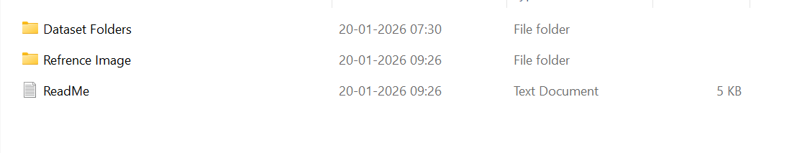
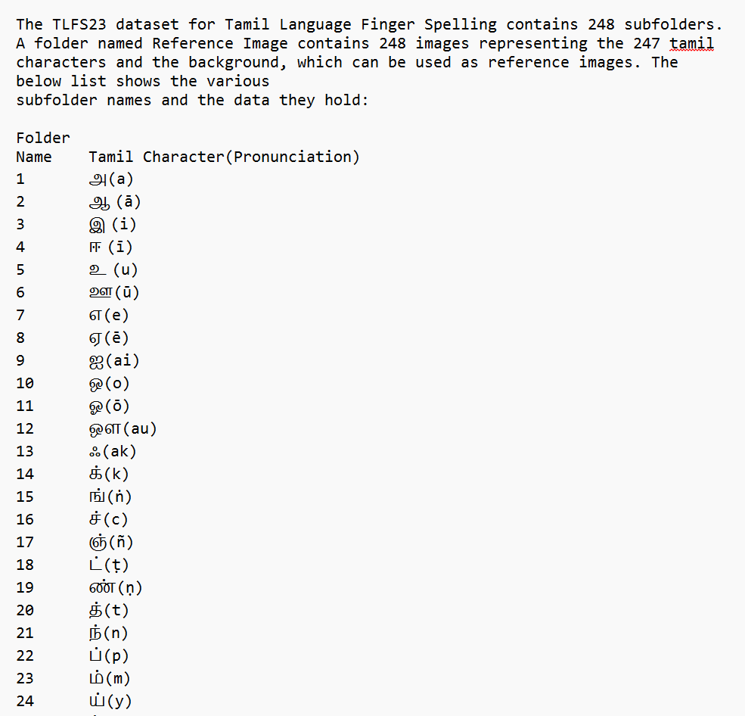
Dataset Snapshots
1.
Shows the different folders present in the TLF 23 Dataset.
2.
Contents of ReadMe.txt , depicting all the mappings between:
Tamil alphabets Numerical Label

Slide 17
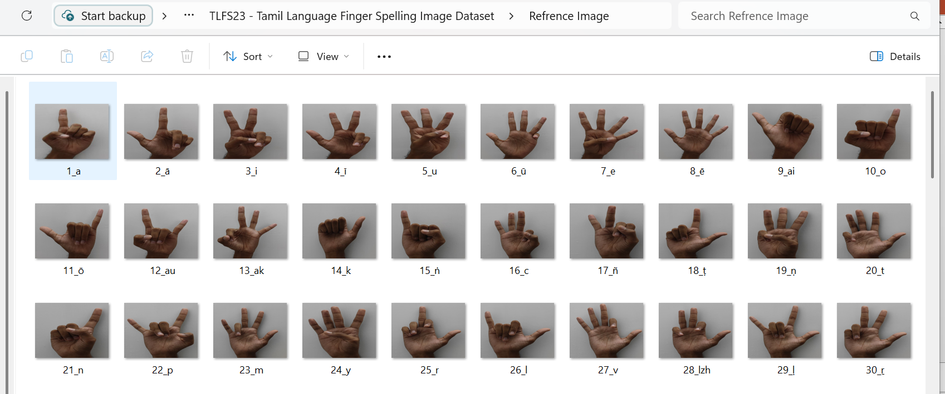
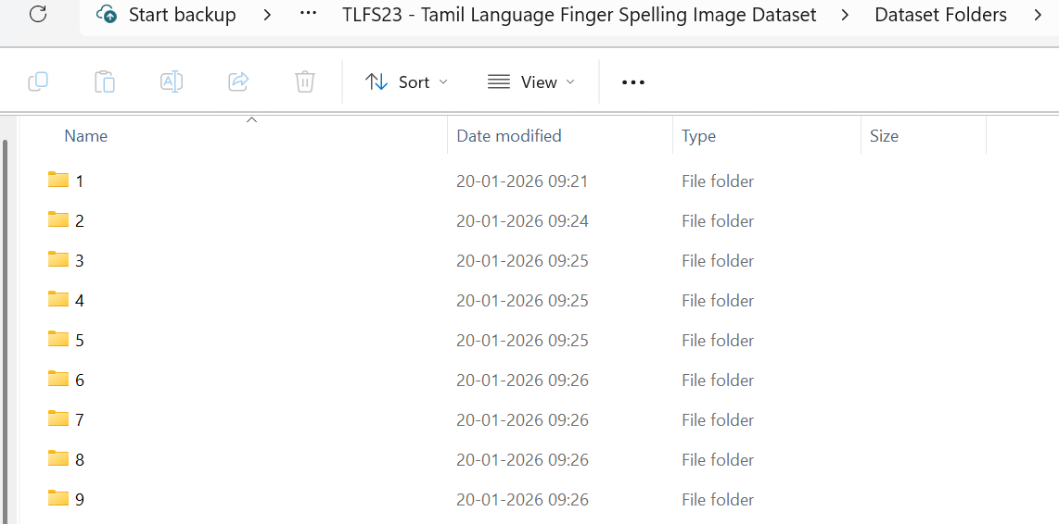
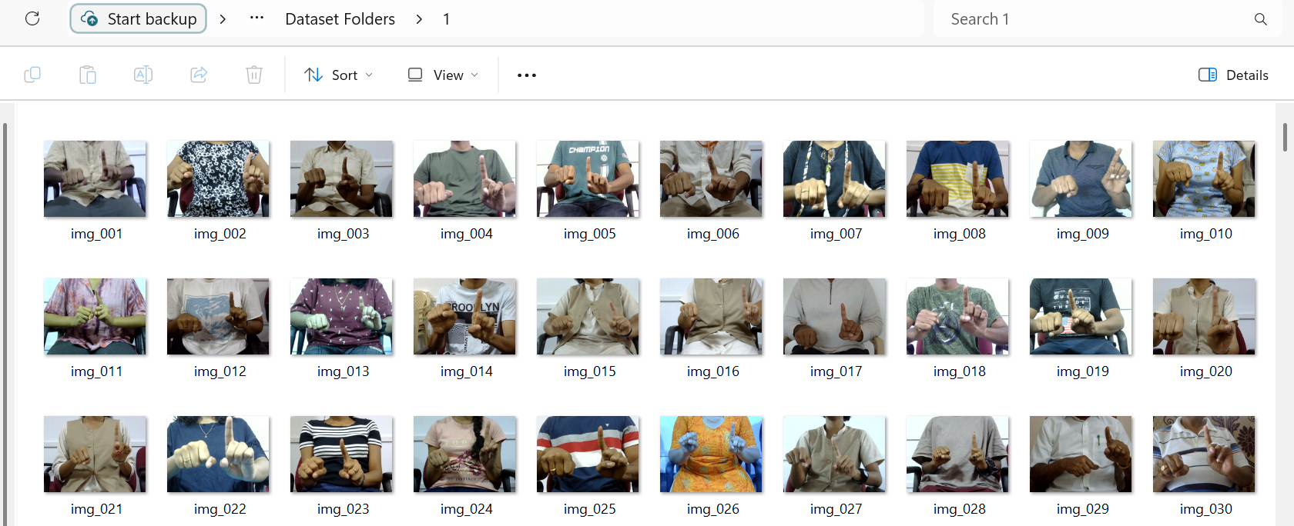
Dataset Snapshots
3.
Sign Language of Tamil alphabets in a plain background
4.
Different background sign images for each tamil alphabet
Same gesture for one of the tamil alphabets, under different backgrounds.

